Slide 1
Chapter 6: The Repetition Structure

Slide 2
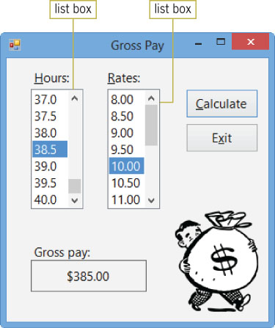
Previewing the Gross Pay Application
Figure 6-1 Gross pay shown in the interface

Slide 3
Lesson A Objectives
After studying Lesson A, you should be able to:
Explain the difference between a pretest loop and a posttest loop
Include pretest and posttest loops in pseudocode and in a flowchart
Write a Do…Loop statement

Slide 4
Lesson A Objectives (cont.)
Stop an infinite loop
Utilize counters and accumulators
Abbreviate assignment statements using the arithmetic assignment operators
Code a counter-controlled loop using the For…Next statement

Slide 5
Repeating Program Instructions
Repetition structure (also called a loop)
Allows the computer to repeatedly process one or more program instructions
Looping condition
Indicates when the computer should continue “looping” through the instructions
Loop exit condition
The requirement for not repeating the instructions
It tells the computer when to exit (or stop) the loop
Loop body
The statements inside the loop

Slide 6
Repeating Program Instructions (cont.)
The Savings Account Application (cont.)
Pretest loop
Evaluates the condition before processing the instructions
Posttest loop
Evaluates the condition after processing the instructions

Slide 7
The Do…Loop Statement
Do…Loop statement
Used to code both a pretest loop and a posttest loop
Two variations of syntax:
While keyword: Indicates that instructions should be processed while the condition is true
Until keyword: Indicates that instructions should be processed until the condition becomes true

Slide 8
The Do…Loop Statement (cont.)
The Do…Loop statement begins with the Do clause and ends with the Loop clause
Instructions to be repeated are placed between the Do and Loop clauses
Use the While or Until keyword before the condition
The condition must evaluate to Boolean True or False
Location of the { While | Until } condition:
Pretest loop: Appears in the Do clause
Posttest loop: Appears in the Loop clause
A diamond represents the loop condition in a flowchart

Slide 9
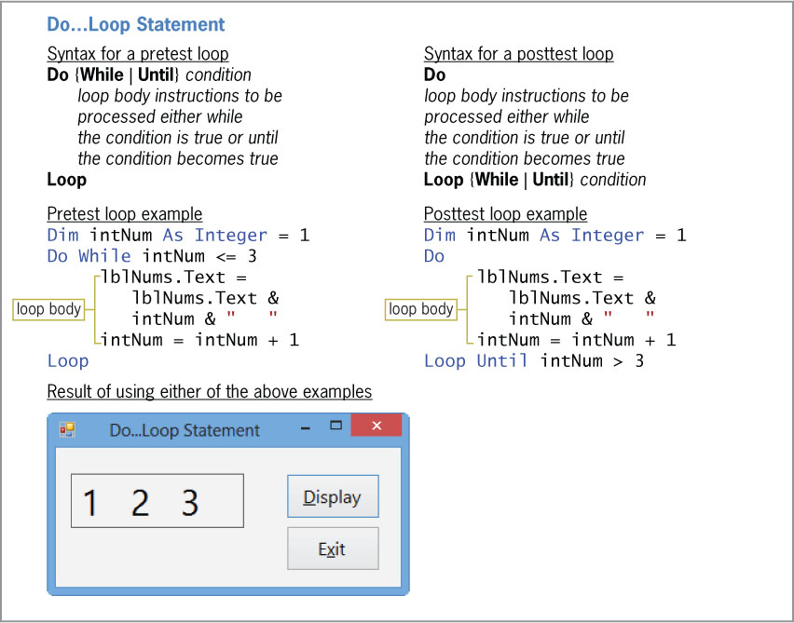
The Do…Loop Statement (cont.)
Figure 6-7 Syntax versions and examples of the Do…Loop statement

Slide 10
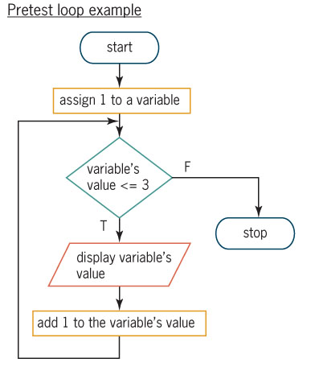
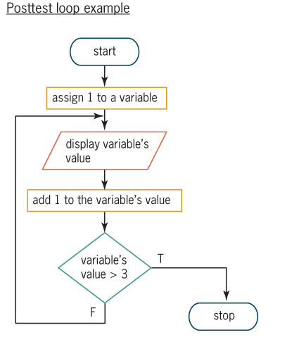
The Do…Loop Statement (cont.)
Figure 6-9 Flowcharts for the loop examples from Figure 6-7

Slide 11
You Do It 2
Page 340
Use code on page 337 as an example

Slide 12
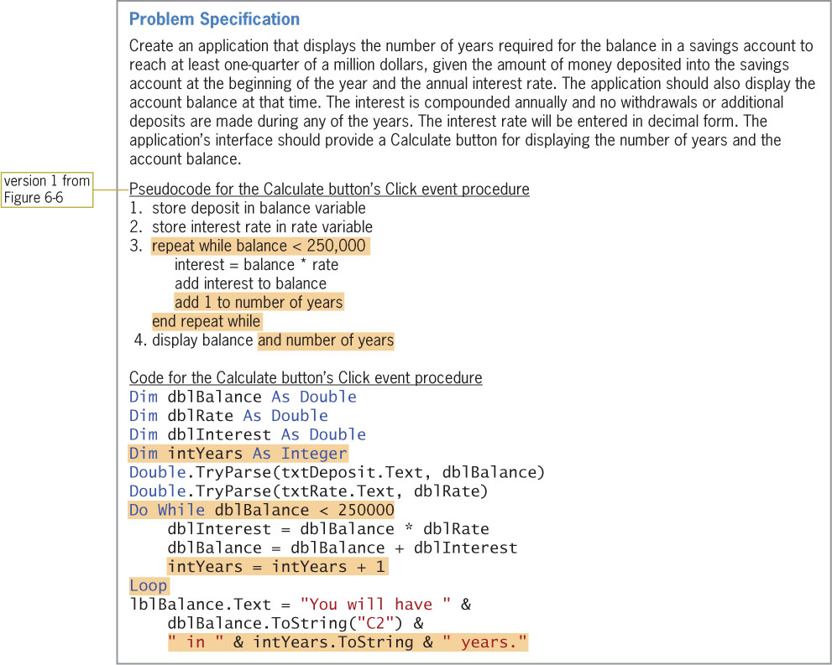
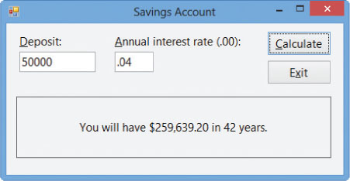
The Do…Loop Statement (cont.)
Coding the Modified Savings Account Application
Figure 6-10 Problem specification, pseudocode, and code for the modified Savings Account application
Figure 6-11 Sample run of the modified Savings Account application

Slide 13
Look at Savings Solution Code
Code on page 340
Run program
Enter 0 as the amount

Slide 14
The Do…Loop Statement (cont.)
Coding the Modified Savings Account Application (cont.)
Infinite loop
Also called an endless loop
The condition to end the loop is never met
To stop an infinite loop:
Click Debug on the menu bar
Then click Stop Debugging

Slide 15
Counters and Accumulators
Used to calculate subtotals, totals, and averages
Counter
A numeric variable used for counting
Accumulator
A numeric variable used for accumulating (adding together) something
Initializing
Assigning a beginning value
Updating (incrementing)
Adding a number to the accumulator’s value
The number can be positive or negative
Done within the loop body

Slide 16
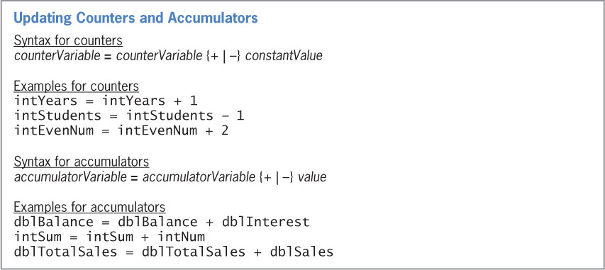
Counters and Accumulators (cont.)
Figure 6-14 Syntax and examples of update statements for counters and accumulators

Slide 17
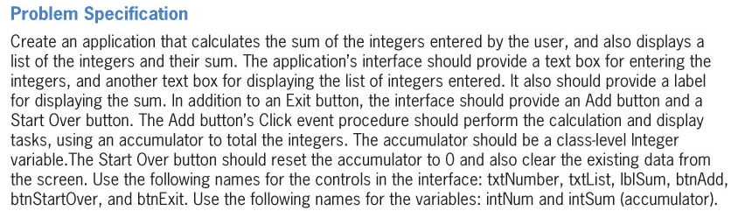
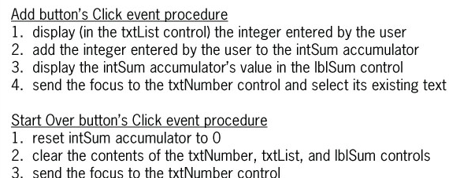
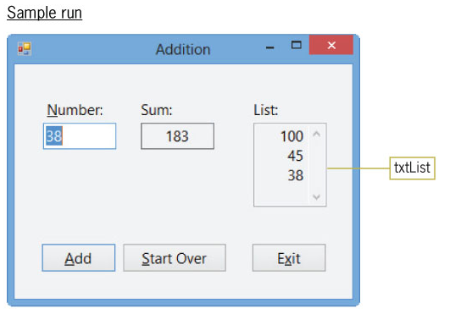
Counters and Accumulators (cont.)
The Addition Application
Figure 6-16 Problem specification, pseudocode, and a sample run for the Addition application

Slide 18
Counters and Accumulators (cont.)
The Addition Application (cont.)
Multiline property
When set to True, the text box can both accept and display multiple lines of text
ReadOnly property
When set to True, it prevents the user from changing the contents of the text box during run time
The default is False
ScrollBars property
Specifies whether the text box has no scroll bars (the default)

Slide 19
Code the Addition Application
Page 347

Slide 20
You Do it #3
Page 348

Slide 21
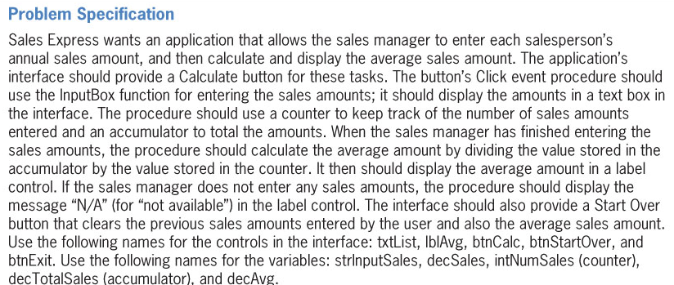
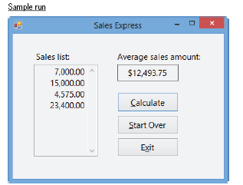
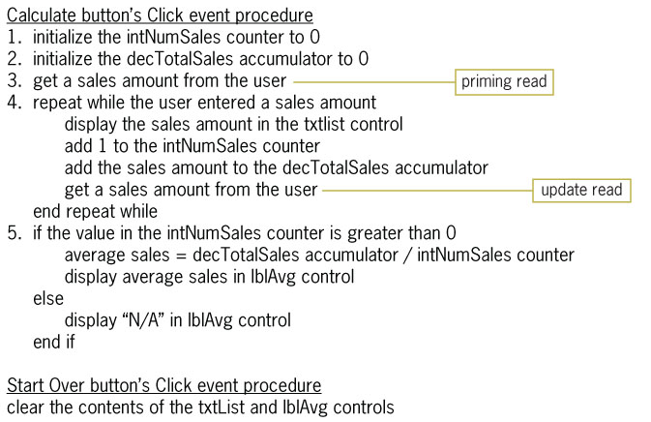
Counters and Accumulators (cont.)
The Sales Express Application
Figure 6-20 Problem specification, pseudocode, and a sample run for the Sales Express application

Slide 22
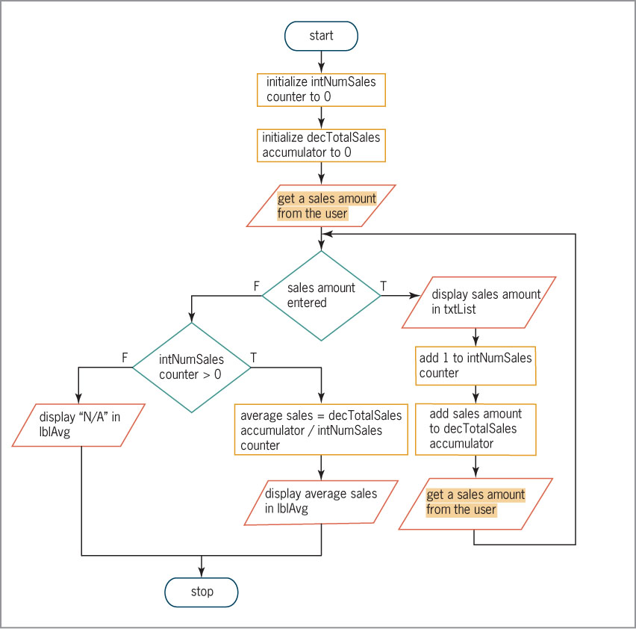
Counters and Accumulators (cont.)
The Sales Express Application (cont.)
Objective: Calculate the average sales amount
Uses the pretest loop
Priming read
Used to set up the loop by performing the first action prior to entering the loop
Update read
Allows the user to update the value that controls the loop’s condition
Figure 6-21 Flowchart for the Calculate button’s Click event procedure

Slide 23
Code the Sales Express Application
Page 354

Slide 24
You Do it 4
Page 355

Slide 25
Arithmetic Assignment Operators
Arithmetic assignment operators
Used to abbreviate an assignment statement containing an arithmetic operator
Format:
variableName = variableName arithmeticOperator value
Example:
intAge = intAge + 1 can be abbreviated
intAge += 1

Slide 26
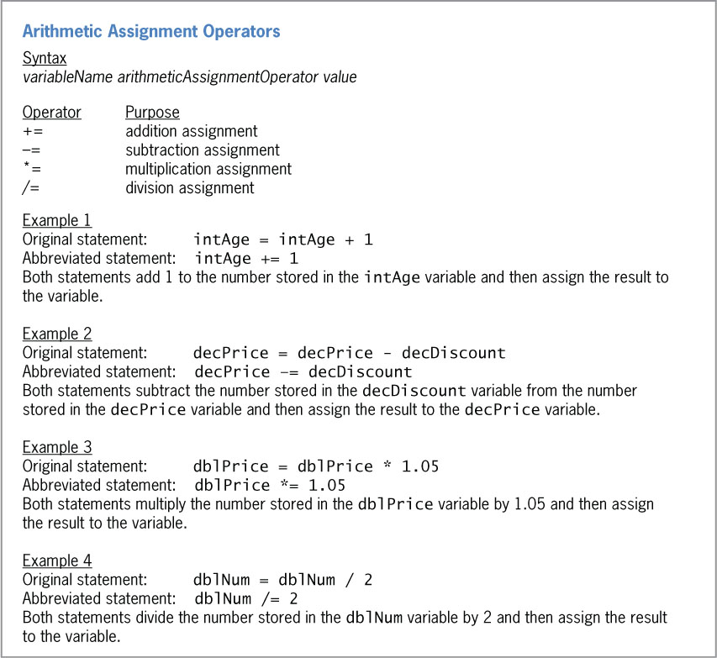
Arithmetic Assignment Operators (cont.)
6-26 Syntax and examples of the arithmetic assignment operators

Slide 27
The For…Next Statement
For…Next statement
Used to code a counter-controlled loop
Processes instructions a precise number of times
The condition is tested before processing (pretest loop)
You must specify the start value, end value, and step value
The start value and end value provide the looping range
The step value increments or decrements the counter
The For clause is represented by a hexagon in a flowchart

Slide 28
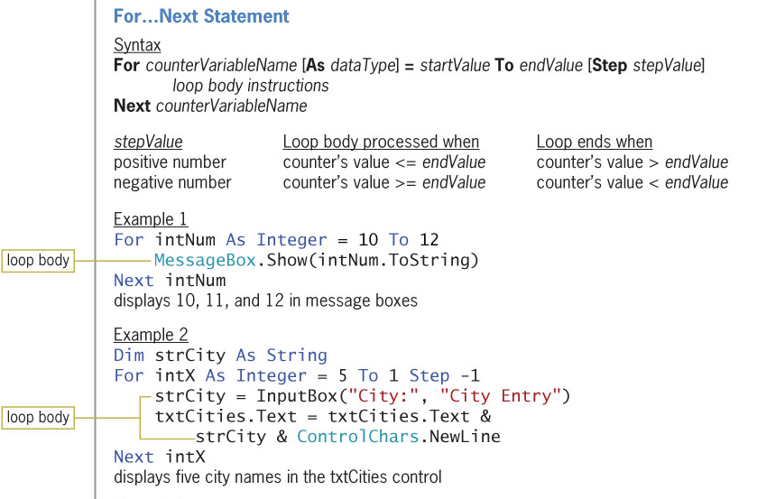
The For…Next Statement (cont.)
Figure 6-28 For…Next statement’s syntax, examples, and processing tasks (continues)

Slide 29
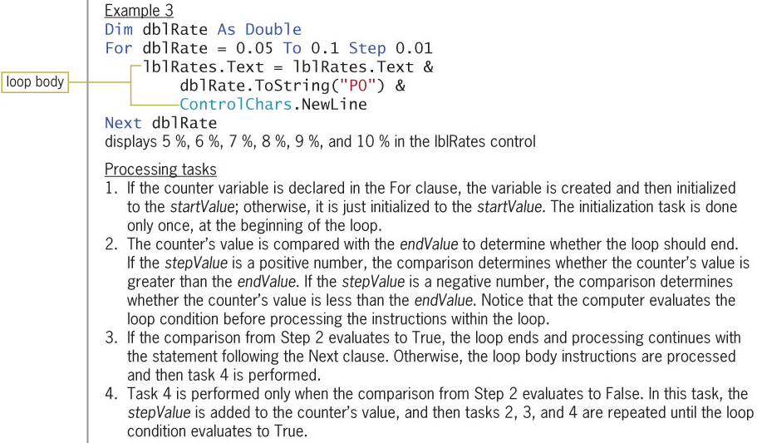
The For…Next Statement (cont.)
(continued)
Figure 6-28 For…Next statement’s syntax, examples, and processing tasks

Slide 30
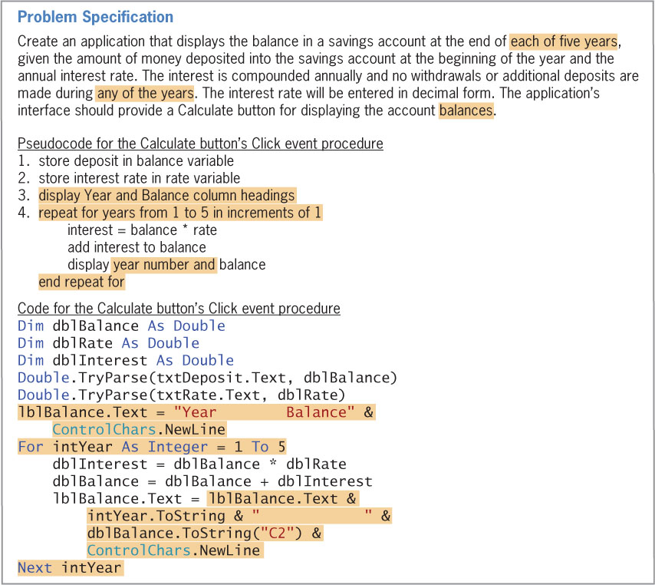
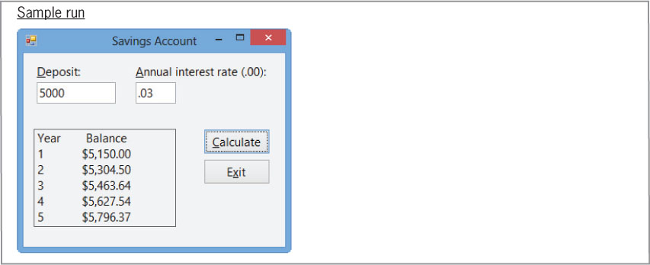
The For…Next Statement (cont.)
A Different Version of the Savings Account Application
Figure 6-30 Problem specification, pseudocode, code, and sample run for another version of the Savings Account application

Slide 31
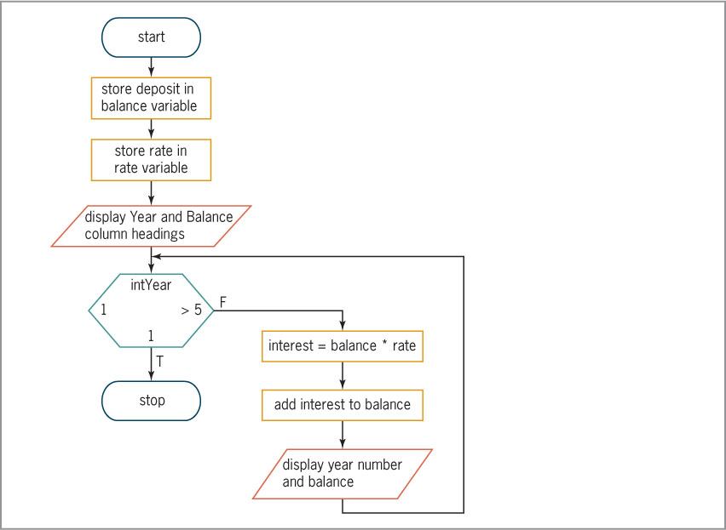
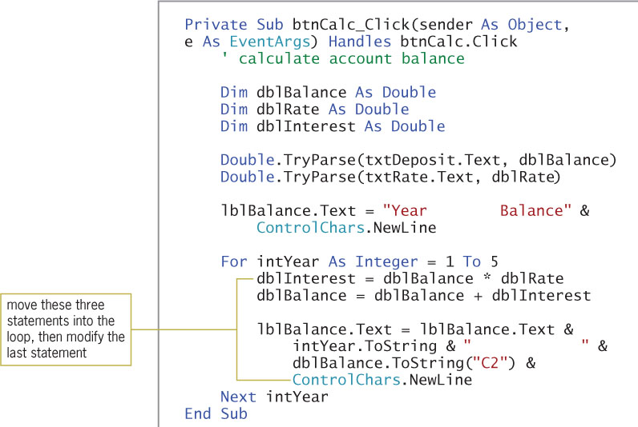
The For…Next Statement (cont.)
A Different Version of the Savings Account Application (cont.)
Figure 6-31 Flowchart for the Calculate button’s Click event procedure
Figure 6-32 Completed btnCalc_Click procedure

Slide 32
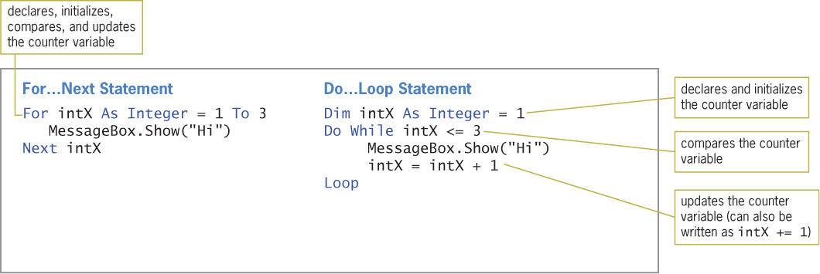
The For…Next Statement (cont.)
Comparing the For…Next and Do…Loop Statements
Figure 6-33 Comparison of the For…Next and Do…Loop statements

Slide 33
Code the For Next version of the Saving Application
Code on page 362

Slide 34
You Do It 5
363

Slide 35
Lesson A Summary
The repetition structure (loop) repeats a set of instructions until some condition is met
A Do…Loop can be used to code both pretest and posttest loops
The Decision symbol is used to represent a Do…Loop in a flowchart
Endless loops can be stopped by clicking DEBUG on the menu bar and then clicking Stop debugging

Slide 36
Lesson A Summary (cont.)
Counters and accumulators must be:
Initialized
Updated within a loop
Arithmetic assignment operators are used to abbreviate an assignment statement
The For…Next statement can be used to code pretest loops only
To flowchart a For…Next loop, use the hexagon to represent the For clause

Slide 37
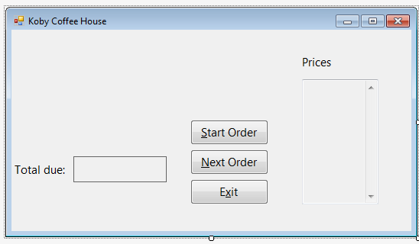
Homework #1
Assignment # 24 page 372
Change the UI to include a text box that lists all the orders
Include a loop Enter a Zero to end the loop

Slide 38
Homework #2
Assignment # 25 page 373

